Slide 1
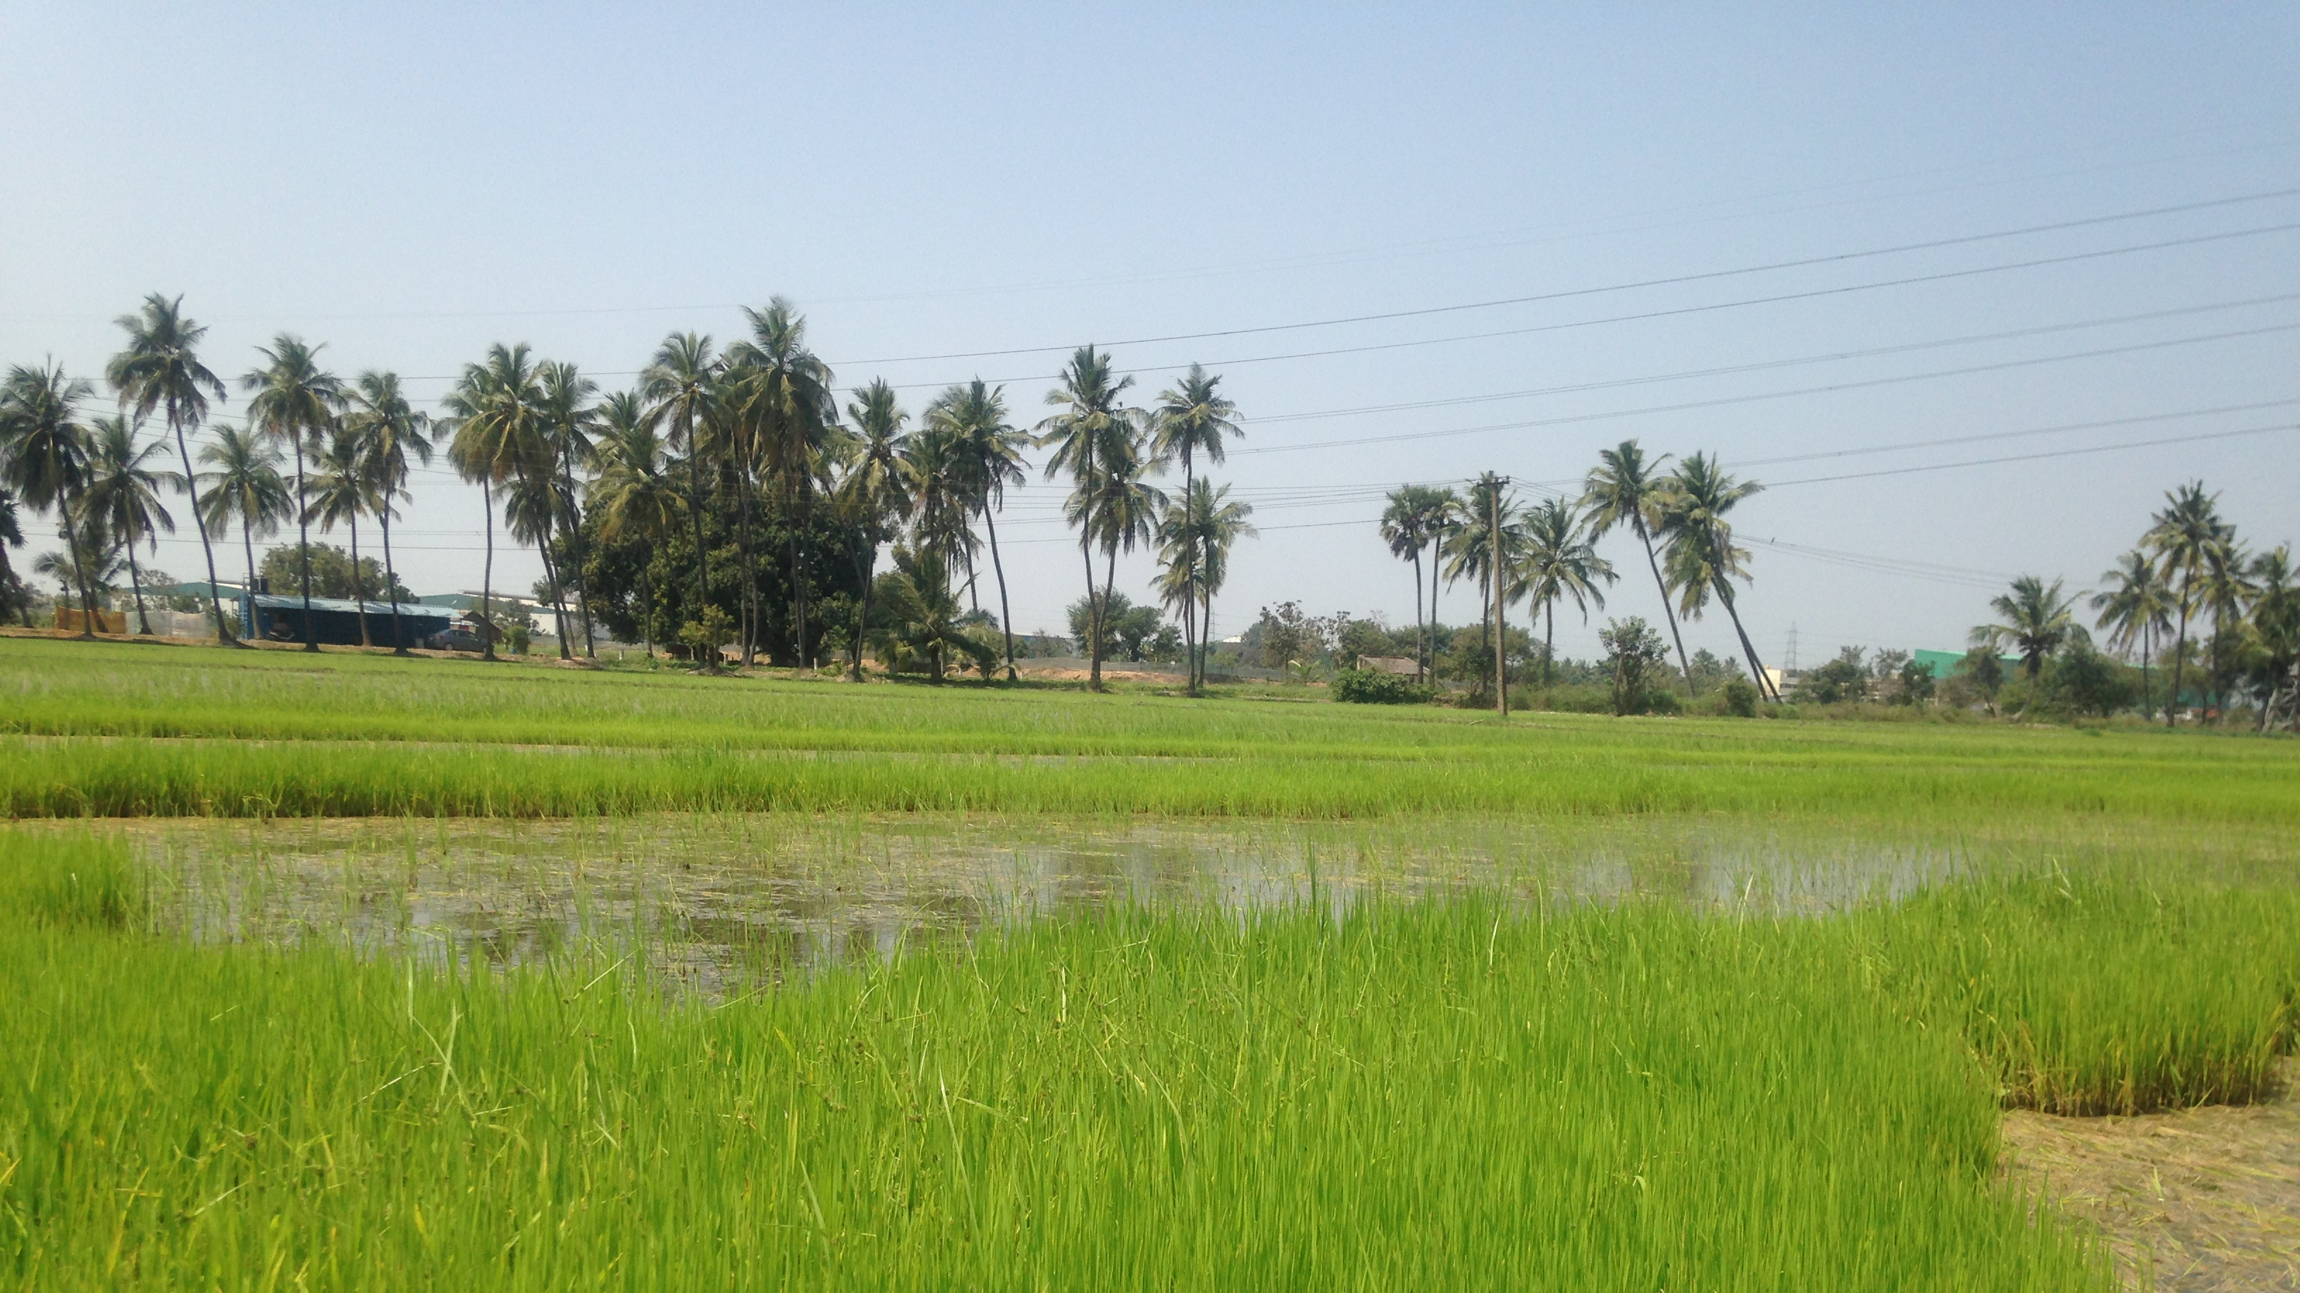
AI ASSISTED FARMING SOLUTION
- ELECTRIC GUEST

Slide 2
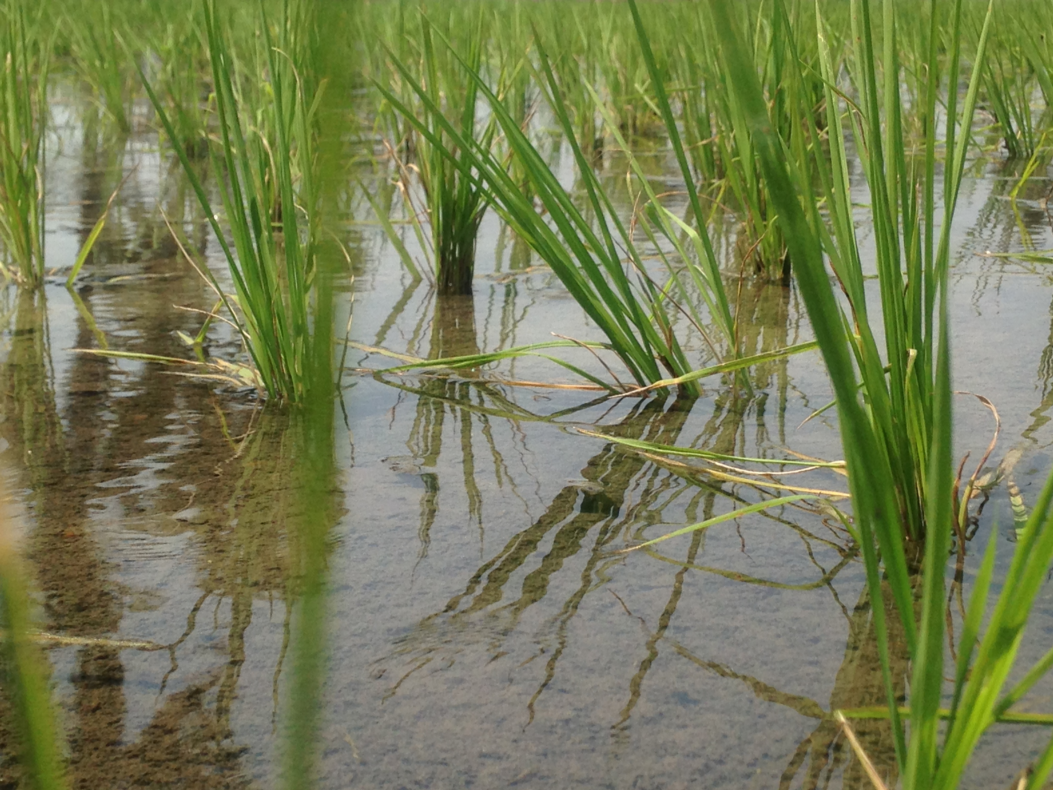
PURPOSE
To build an application that can be used by farmers throughout India to get accurate information on which crops to be planted
By using various IBM services, we can help farmers get the best yield and revenue from their hard-work and land
Modernize Farming and bring it to Industry 4.0 standards

Slide 3
SOLUTION
The idea can be split into 3 parts:
Auto AI Model to give crop recommendation to farmers and give information on revenue
IOT Device and Platform to give Real-Time Predictive Analysis
Django Web Application as a portal for farmers to access these Services.

Slide 4
NOVELTY
Community Based Dashboard Solution
User Oriented Platform

Slide 5
PROBLEMS SOLVED DURING CHALLENGE
Cloud Foundry for lite users
Cloud Foundry for IOT Platform
Watson Studio 20CUH Limit

Slide 6
RESULTS ACHIEVED
Auto AI Model Built with Accuracy of 99.1%
IOT Platform Built for Crop Sense Device
Django Application Launched. Crop Speak (mybluemix.net)

Slide 7
FUTURE SCOPE
Automated Manure/Fertilizer Dispenser using Sprinklers as Hardware when the soil nutrient levels are low.
Pest/Disease Detection using Cameras and Surveillance systems for crops so that farmers can be alerted on the presence of rodents/pests on their farms.

Slide 8
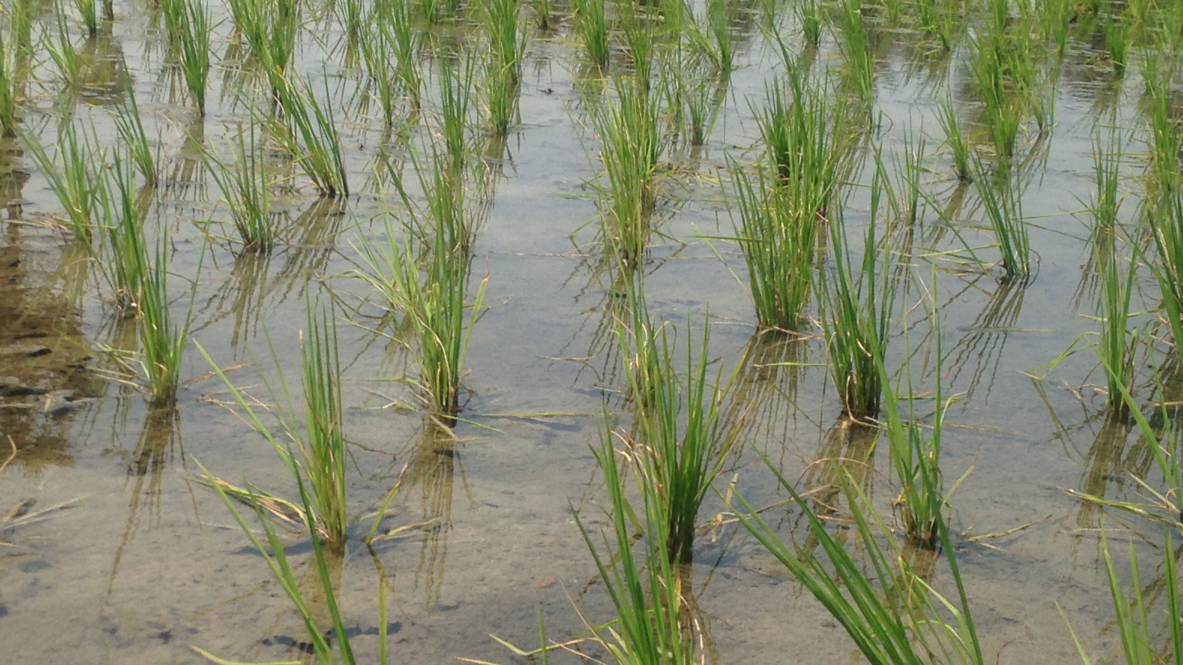
THANK YOU

